Slide 1

Introduction to Python Python Basics and Data Exploration
Rutgers University Library Graduate Specialist Program Workshop Series
Presenter: Ziqiu Zhong (Sly)
Oct.8th 2019

Slide 2

Let’s Get Started
Download Python3: https://www.python.org/downloads/
Online Python IDE: https://repl.it/languages/python3
Official Tutorial: https://www.learnpython.org
Step by Step Learning on Codecademy: https://www.codecademy.com/courses/learn-python/lessons/python-syntax/exercises/print-statements?action=resume_content_item
More Resources offered by Rutgers University Libraries: https://libguides.rutgers.edu/graduatespecialist/python

Slide 3
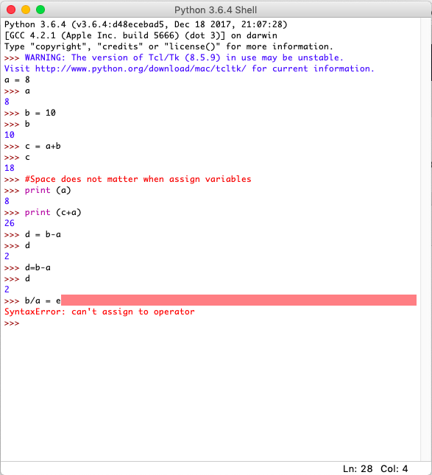

Variable Assignment
# This is a comment. Comments will not appear in the output when a cell is run.
= Assigns the value to the letter “a”
print() function displays the value of the argument that's passed to it (e.g. whatever is inside the parentheses).
Assigned Variables have to be on the front.
Notes:
Q: What is the term for the assigned variable. E.g. “a” in a = 6.

Slide 4
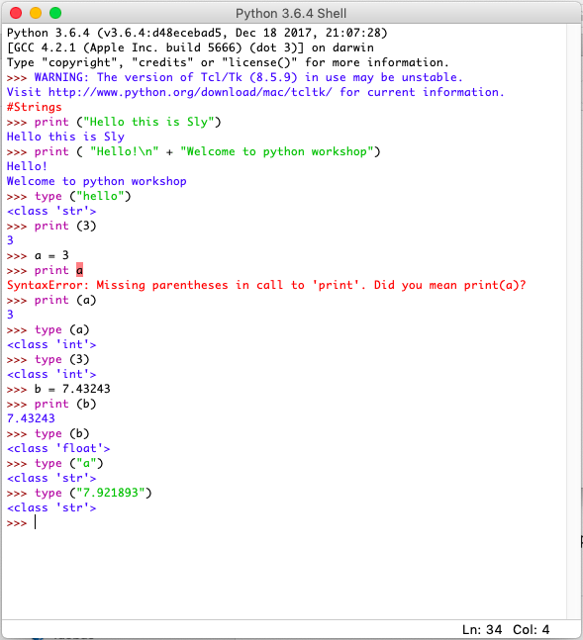
Data Types
Integer: A whole number with no decimal point
Float: The float type in Python designates a floating-point number. float values are specified with a decimal point.
Strings: a series of letters, numbers, or symbols connected in order — as if threaded together by string.
Type() tells you the data type.

Slide 5
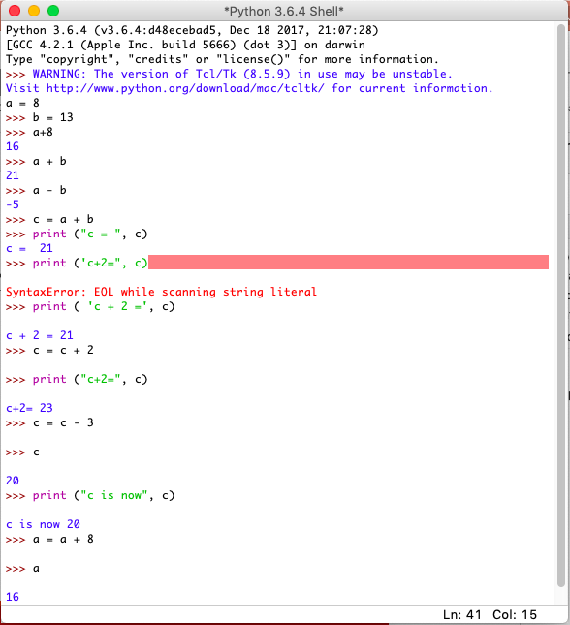
Basic Calculations
Increment a + b*
subtraction: a - b
multiplication: a * b
division: a / b
floor division (the integer part, or quotient, of a division operation): a // b
modulo (remainder): a % b

Slide 6
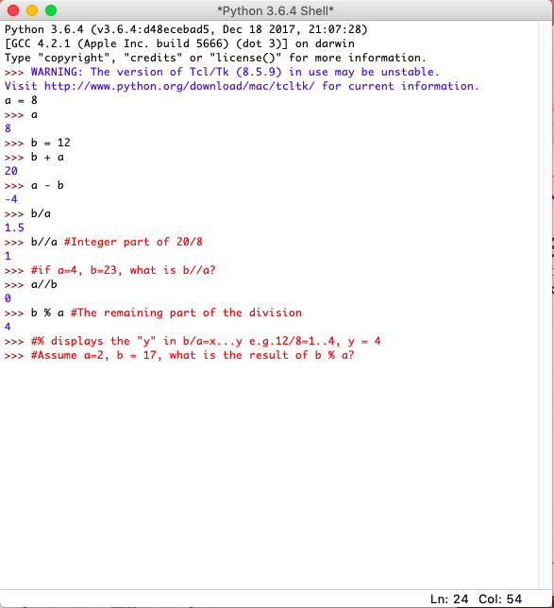
Basic Calculations
Increment a + b*
subtraction: a - b
multiplication: a * b
division: a / b
floor division (the integer part, or quotient, of a division operation): a // b
modulo (remainder): a % b
Notes:
If a=4, b = 23, b//a=5 (23/4=5.75)
If a=2, b = 17, b % a=1

Slide 7
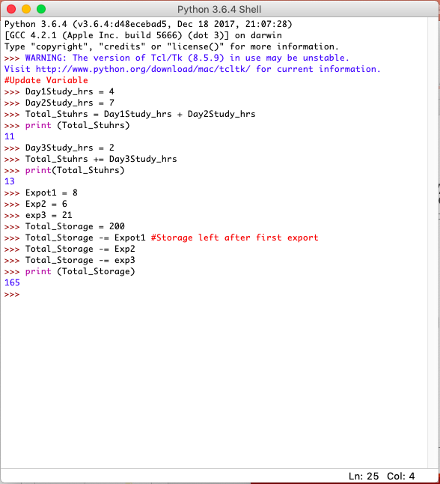
Updating Variables
data should be updated to reflect changes that have happened.
Adding to original variable: +=
Subtract from original variable: -=

Slide 8
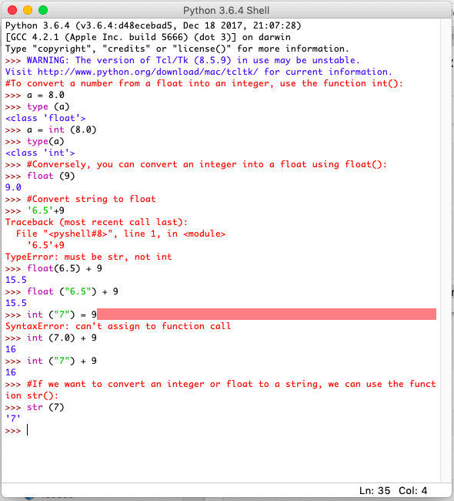
Convert Data Types
Strings: a series of letters, numbers, or symbols connected in order — as if threaded together by string.
Float: The float type in Python designates a floating-point number. float values are specified with a decimal point.
Integer
Type() tells you the data type.

Slide 9
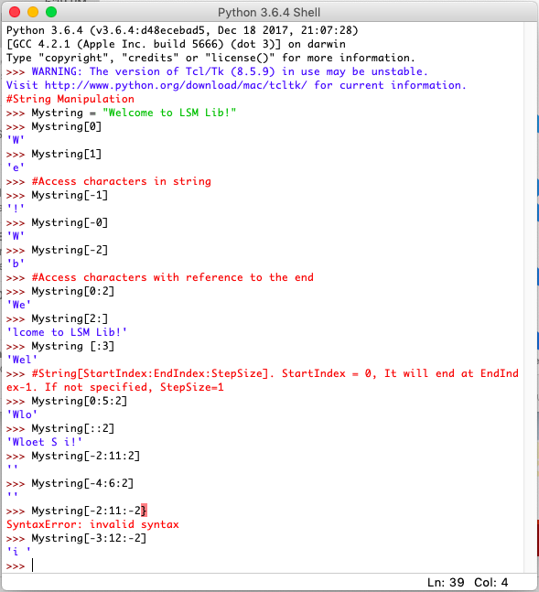
String Manipulation
String starts at 0
String [StartIndex:EndIndex:StepSize]
EndIndex = Index Number -1
Q: What is [0:3], [1:-2]for “Hello”
More String manipulation see:
Code cell 30
H | e | l | l | o
0 | 1 | 2 | 3 | 4
-4 | -3 | -2 | -1 | -0
Notes:
>>> String = "Hello"
>>> String[0:3]
'Hel’
>>> String[1:-2]
'el'

Slide 10
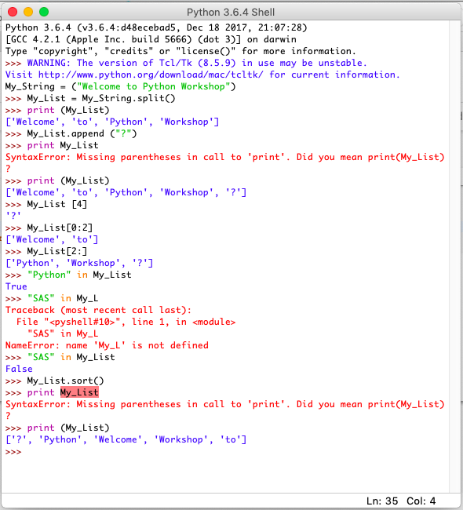
Lists
Lists: They can contain any type of variable and they can contain as many as you wish. A list can even have another list as an item.
Created by placing all the items (elements) inside a square bracket [ ], separated by commas.

